Slide 1
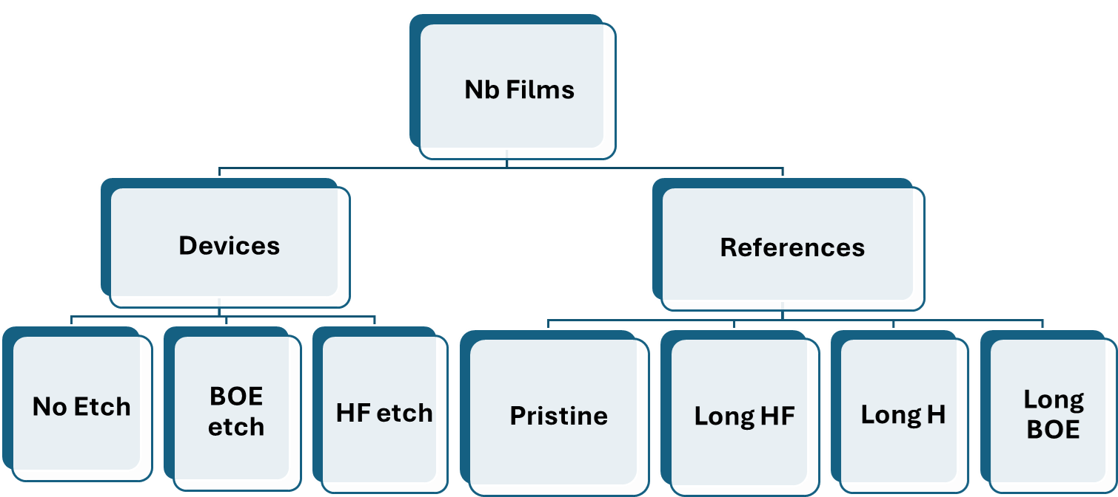
Possible NASA samples for Raman
(red means we are publishing something on these samples soon and if we can figure out how to fit the Raman analysis in with the paper story, we can include it)
Nb (paper on oxides): 50 and 250 nm mostly
NbTiN (more options for what peaks could be)
Al doped with Mn: heating series (paper not related to oxides, might not tie in as well)
One group is looking at some heated NASA Nb samples that should probably have more oxide signal so that we can hopefully better see the likely oxide peaks. They are also looking at 2 thicknesses.
Ask questions if you have them!

Slide 2
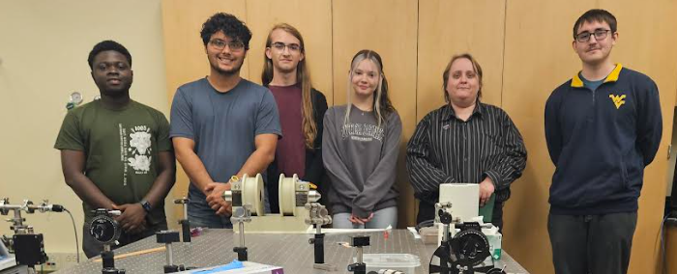
MOKE progress
Most of setup aligned
Need: sample holder, chopper and lock-in, data collection

Slide 3
Today’s topics
Intensity
Laser safety basics
Discussion of Raman spectroscopy
How to identify peak locations
Smoothing noisy data
Digitalizing reference data (don’t forget to cite it!)
Before we start discussing more on Raman, let’s take a quick look at the class schedule.
Raman Shift (cm⁻¹)

Slide 4

Mildly Revised Schedule
Lab Notebook Check-In is 25% of the lab notebook grade (25% of 20%, so 5% of your grade). The point is to make sure you are on track with including the right things in your lab notebook, such that you can score well on that rubric at the end of the semester.
I will grade four sections of the following rubric, but I can check 2 others if you are ready.
We are here
Flexibility if needed
Guest
Would we prefer others?
Questions?
/Setup
Notes:
Probably want to get Ned to come one of the next two (one without a tour though) and then also invite to the group presentations

Slide 5
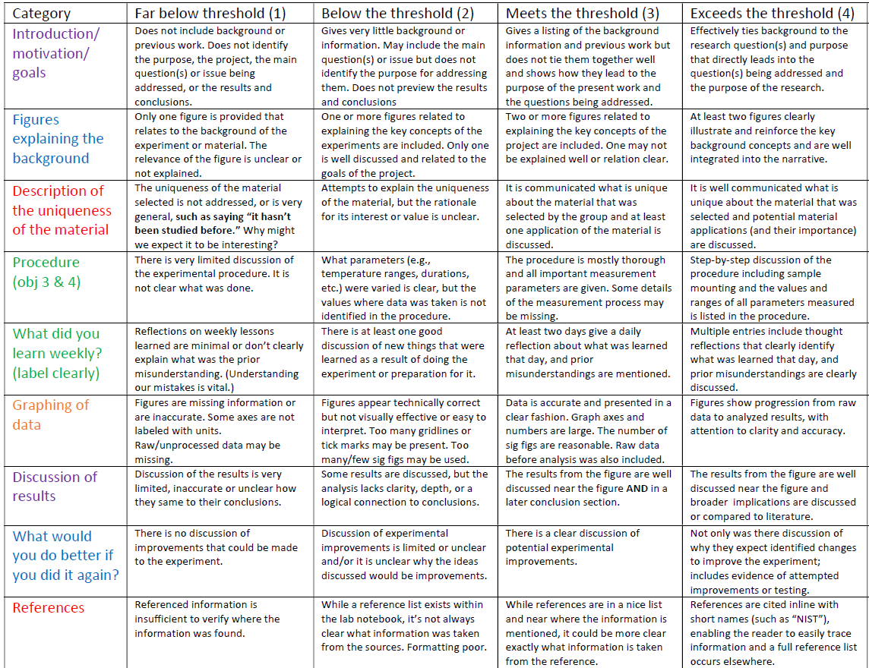
I can tell you how good these are if you give them a try.
Raman – how will you identify any peaks you see? MOKE – what do you expect to observe? (Background)
Not ready yet.
Notes:
The four yellow sections are the ones I’m grading for this initial notebook check, but I will also give guidance on procedure and weekly learning if you want a practice run at those. I can point out what is good and what needs improvement. The initial check will make up 25% of your lab notebook grade.
At the end of the semester, I will check all sections. While I will have already graded 4 sections, if I asked questions and you didn’t get a 4 in any of those sections, you can expand upon those sections for a better grade for the end of semester notebook check.

Slide 6
Next Major Homework: Graph/Setup
Graphs and setup rubrics are on class website under Additional Materials, along with several MOKE and Raman references. These references are not required, but are there in case you want to learn more.
We are here
Flexibility if needed
Questions?
/Setup
Notes:
Probably want to get Ned to come one of the next two (one without a tour though) and then also invite to the group presentations. Ideally one where Brian doesn’t come. Need to figure out that date.

Slide 7
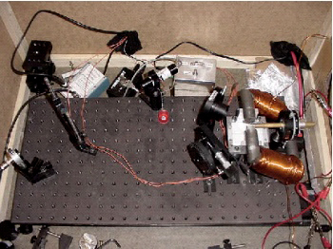
Is this a useful experimental setup? Why or why not?
Homebuilt MOKE system used at Montana State University
Is it acceptable for the lab notebook?
Hand out lab setup rubrics for the MOKE students
Notes:
Yes, but you’d want to accompany it with a better experimental setup diagram. It’s almost impossible to tell what any of this is.

Slide 8
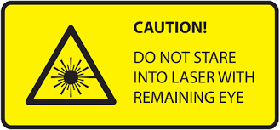
Bare Minimum Laser Safety
1. Never look directly into a laser beam or its reflection. (Close eyes when bending.)
Even a low-power laser can cause eye damage. Treat every beam as if it’s dangerous.
2. Know where the beam is — and where it might go.
Keep the beam at or below chest height (never eye level). Avoid shiny or reflective objects in the beam path.
3. Only turn on the laser when you are ready and the area is clear.
Announce “Laser on!” before powering up. Make sure no one’s leaning over the optics table.
4. Wear laser safety glasses if the laser is Class 3B or higher, or as instructed.
Use the glasses that match the wavelength of your laser — not just any tinted glasses.
5. Keep all beam paths enclosed whenever possible.
Use beam blocks or covers to trap stray light. Never let a beam travel beyond the optical table.
6. Never leave an unattended laser running without caution tape. Turn it off when you walk away and/or put up caution tape as warning that laser is in use.

Slide 9
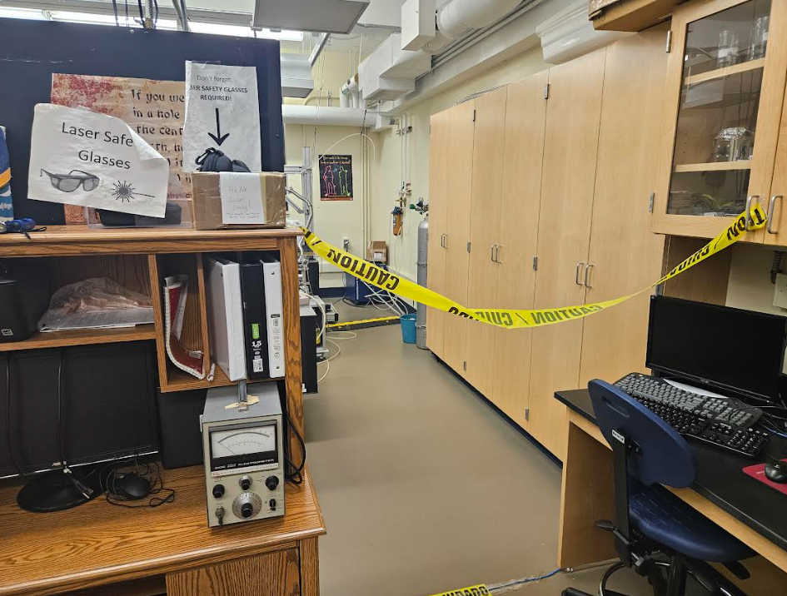
What does this picture mean?
It means laser in use and a user is not currently present. ONLY if data is collecting!
What should you do if you need to go in?
Which ones?
The laser should not be left on if no one is present UNLESS data is collecting.
If someone wants to make a data collection in progress sign for more clarity, that’s not a bad idea.
Notes:
There is also a room in use light at the door, but it is very easy to forget on or off, so don’t rely on that. Though, it is good practice to turn it on when doing stuff in the lab. (In addition to us, it’s useful for non-lab people during an emergency.)
If you have to leave and you are not collecting data, you MUST turn off the laser.

Slide 10
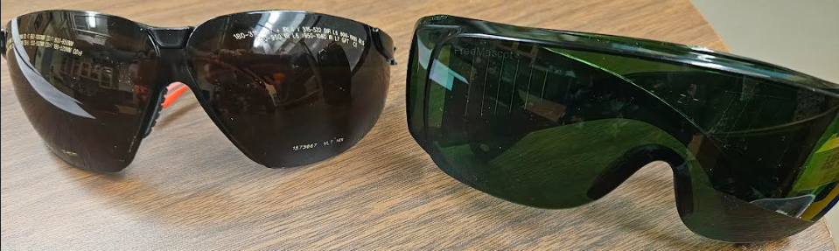
Basics of laser goggles
They have a range which they work and how much they less the light in that range. Details are written on the front of the goggles.
Our current HeNe goggles are green. Since they are OD4+, it lessens the light in that wavelength range by at least a factor of 10^4 = 10,000.
That’s enough for the HeNe laser. They are also not terrible for the other laser, but other goggles 10-100 times better.
These goggles do not cover the HeNe wavelength of 632 nm, but are optimized for ~800 nm and also pretty good for 190-520 nm. Their OD varies on wavelength but is bigger. If can’t find other goggles, these should still be enough.
Notes:
In case they get mixed up
Green ones 10,000 better than naked eye even for fancy laser. I’d still recommend the other goggles if using the fancy laser, but these wouldn’t be terrible.

Slide 11
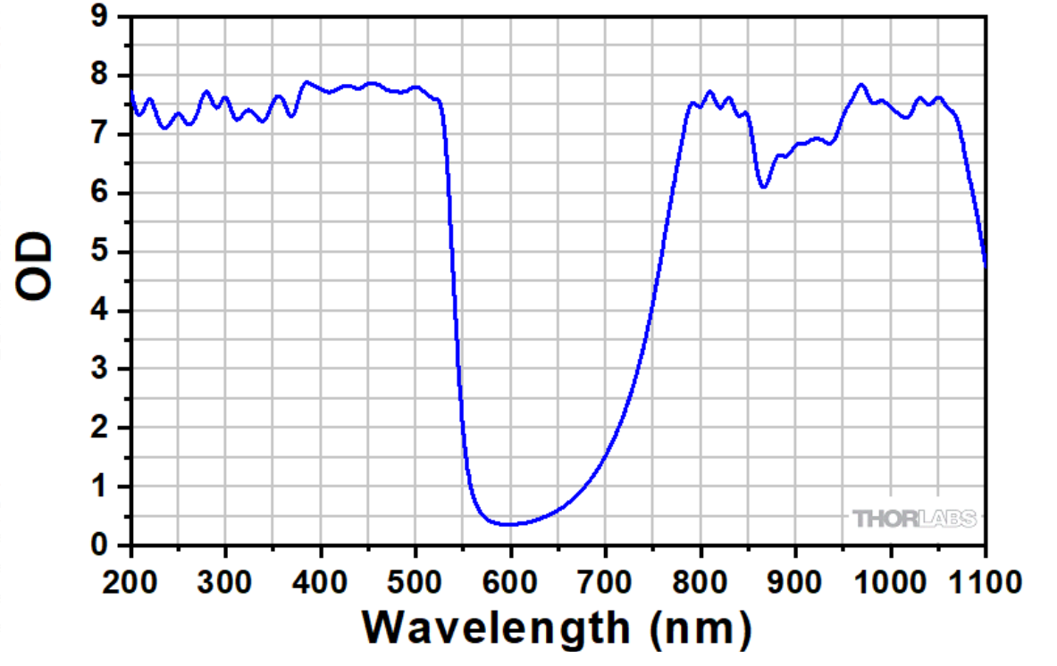
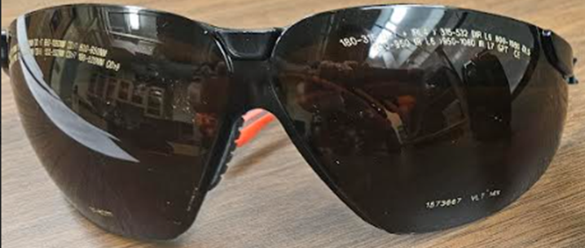
Where do these goggles protect most?
Thus these goggles would be better than nothing for the HeNe, but not by much. We currently have 6 goggles for the HeNe.
OD7 850-1080 nm
OD6 800-850 nm
OD5 750-800 nm
OD3 520-532 nm
OD9 190-520 nm
What isn’t here?
Similar but not the same goggles
Notes:
There isn’t a label on these about a brand number so I wasn’t able to get the exact same curve as our goggles

Slide 12
Our Two Current Goggles (Summary)
Color | Good for HeNe | Good for fancy
Green | Ideal | Ok, but not best
Dark brown | Nope! | Yes, ideal
Do not rely on color! Always check wavelength labels to double check.

Slide 13
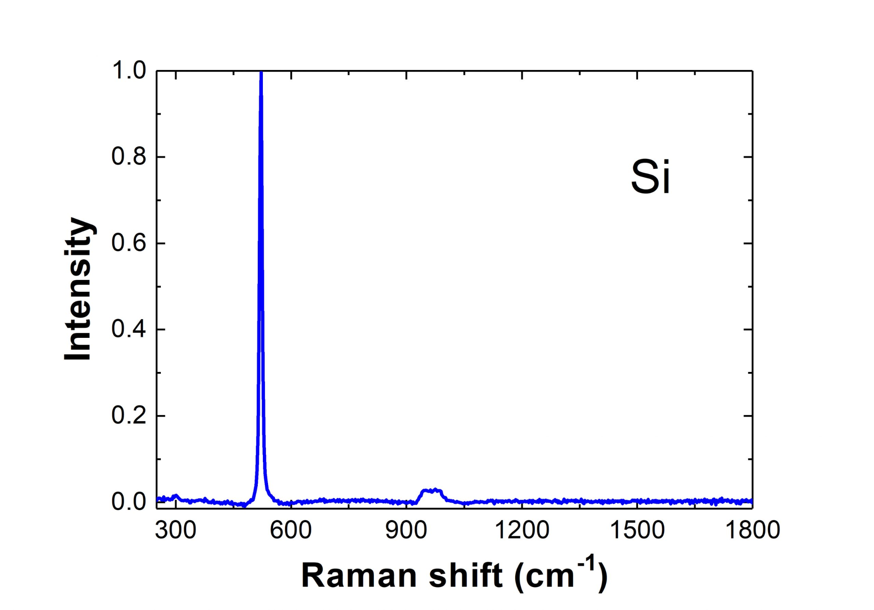
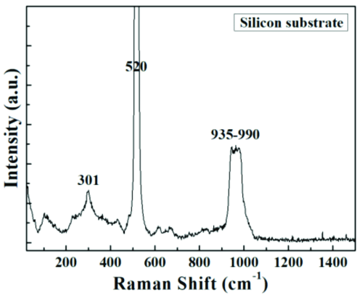
Let’s learn more about silicon’s Raman signal to help us understand Raman better
Notes:
There are some experimental tricks we can play with, but we are still going to have some of this silicon signal in there regardless.

Slide 14
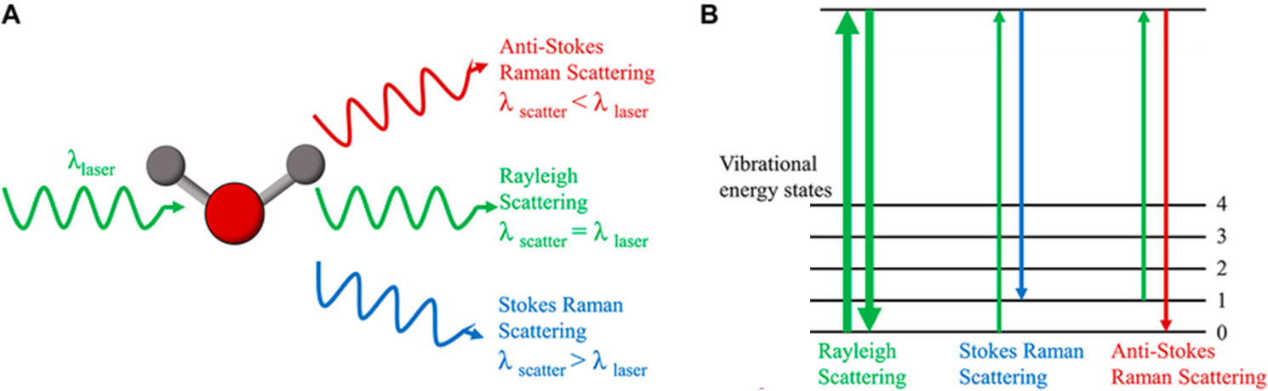
Raman Spectroscopy (review slide)
Shine a laser on a material → most light scatters back the same, but a tiny bit shifts color because of vibrations of the atoms.
Those vibrations act like a “fingerprint” of the material.
Great for checking if the right bonds or phases are present.
Excited state
Raman shift
Elastic
(total
ΔE=0) as in XRD

Slide 15
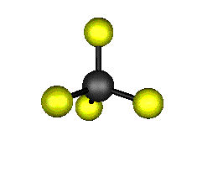
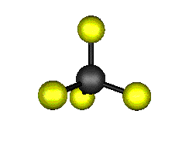


Molecules can vibrate in different ways, like stretching or bending their bonds
o₃ (F₂) - Asymmetric Stretch
An asymmetric stretch or bend is when different parts of the molecule move in opposite ways at the same time (one bond gets longer while another gets shorter).
For asymmetric vibrations, more than one kind of element is needed. Otherwise, all the bonds are the same and can only move together.
o₁ (A₁) - Symmetric Stretch
520 cm⁻¹ in Si
A symmetric stretch or bend is when all the identical bonds move together in the same way
o₂ (E) - Symmetric Bend
o₄ (F₂) - Asymmetric Bend
In a material made of just one type of atom arranged symmetrically every atom “feels” exactly the same environment. So when one atom moves in a certain way, all the others are required—by symmetry—to move in a matching way.
Notes:
An asymmetric stretch cannot occur in a single-element material because such a material lacks the required internal structural or chemical asymmetry to support such a vibration. For an asymmetric stretch to happen, a molecule or a localized section of a material needs to have at least two different, though potentially identical, chemical bonds or structural features that can be deformed out of phase with each other. This differential deformation is impossible in a single-element material, which has inherent symmetry and identical atomic environments.
Easier to find these modes for molecules than crystal structures, so here I use:
CF₄ (carbon tetrafluoride or tetrafluoromethane) is a tetrahedral molecule with a number of industrial sources.
For CF4 these occur at: o₁ (A₁) - Symmetric Stretch, 921.6 cm⁻¹
o₂ (E) - Symmetric Bend, 439.9 cm⁻¹
o₃ (F₂) - Asymmetric Stretch, 1303.0 cm⁻¹ absorbs at 7.8nm
o₄ (F₂) - Asymmetric Bend, 637.9 cm⁻¹ absorbs at 15.8nm

Slide 16
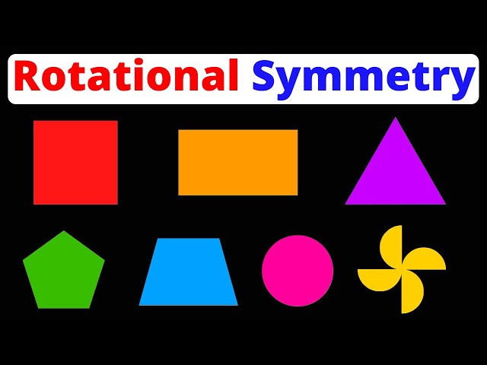
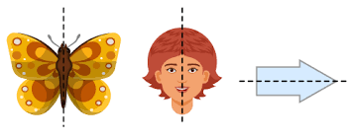
Much about materials physics can be understood purely through understanding the symmetry of the materials!
Mirror Symmetry
In a material made of just one type of atom arranged symmetrically every atom “feels” exactly the same environment. So when one atom moves in a certain way, all the others are required—by symmetry—to move in a matching way.

Slide 17
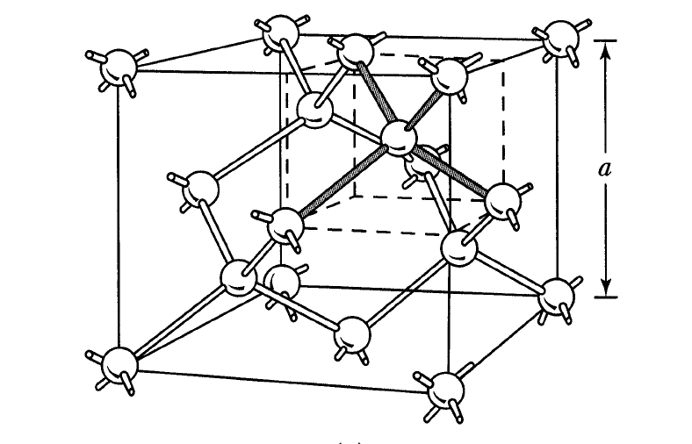
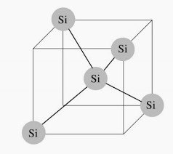
Silicon crystal structure
Each Si has 4 nearest neighbors of Si
Can we get asymmetric vibrations in silicon?
Can we in NbO2?
Not all vibrations show up in Raman -
depends on if vibrations changes molecule's polarizability
Notes:
Not in Si. It only has one type of element.
Possible in Nb oxides.

Slide 18
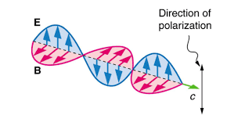
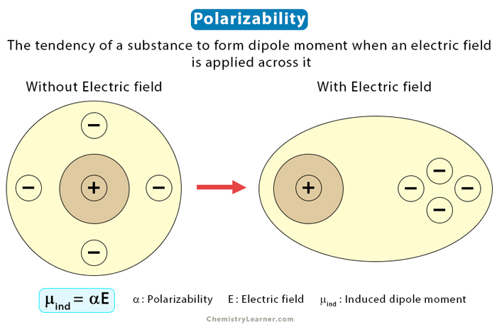
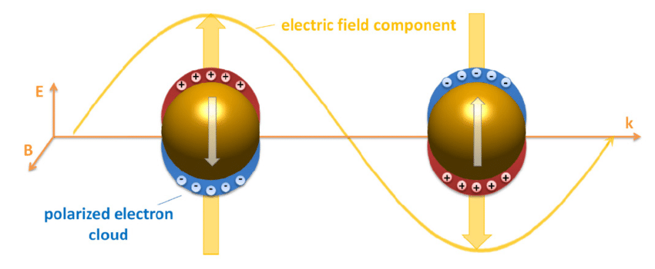
Light in a Raman experiment interacts with how easily the electrons in a molecule can be “pushed around” by an electric field. That property is called polarizability.
If a vibration makes the electron cloud of the molecule easier or harder to distort, then the vibration shows up in the Raman spectrum.
If the vibration does not change how squishy or stiff the electron cloud is, then the laser light can’t “see” it, and it’s Raman-inactive.
Notes:
You might find this interesting: https://youtu.be/LJ2UsmWk63w (cool analogy comparing conductors and insulators to kids at an amusement park)

Slide 19
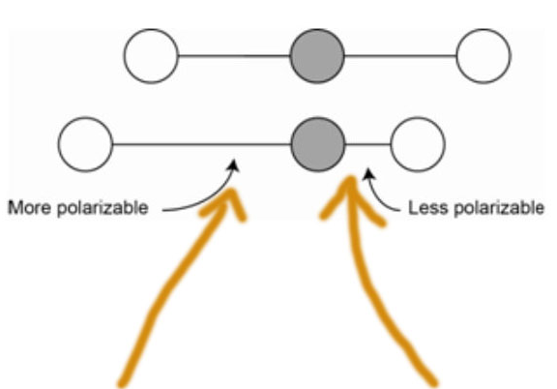
An asymmetric stretch like this would have no overall effect on polarizability and thus be Raman inactive

Slide 20
The main peak in silicon is the symmetric stretch
Notes:
There are some experimental tricks we can play with, but we are still going to have some of this silicon signal in there regardless.

Slide 21
How many musicians do we have in the room?
Notes:
Any guitar players? How do you tune a guitar string? Is that the only frequency that is produced?

Slide 22
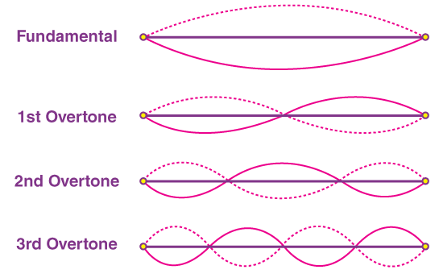
Just like musical notes can combine to make harmonics, two vibrational modes in the crystal can “add together.” This gives weaker peaks at around ~950–1000 cm⁻¹ (about twice 520)
o₁ (A₁) - Symmetric Stretch
520 cm⁻¹ in Si

Slide 23
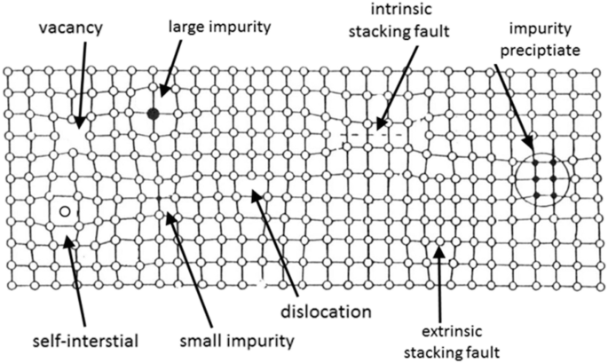
Edge effects (which can be strengthened by defects):
Because a real piece of silicon always has edges and tiny imperfections, some of these “extra” motions become visible to the laser. They don’t show up as strongly as the main one, but you can still see them as smaller bumps, like the one near 300 cm⁻¹ or as shoulders around the main peak. Where these features occur is material specific.

Slide 24
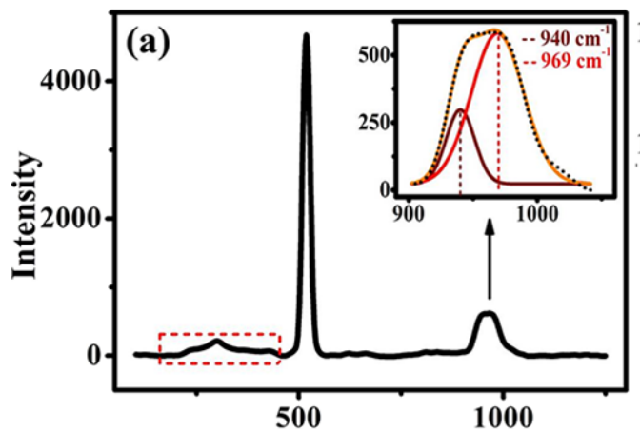
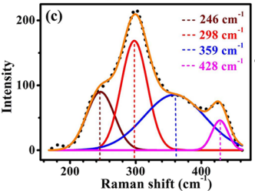
Sometimes you have more than one peak
Many possible types of defects
Intermediate Cu-O-Si Phase in the Cu-SiO₂/Si(111) System: Growth, Elemental, and Electrical Studies
Reshmi Sreedharan, Manu Mohan, Sonia Saini, Anupam Roy, and Kuntala Bhattacharjee
ACS Omega 2021 6 (37), 23826-23836
DOI: 10.1021/acsomega.1c02646
Notes:
Around 960 cm⁻¹, silicon shows two nearby peaks because there are two slightly different ways atoms can combine two of those 520 cm⁻¹ vibrations.
In one combination, the atoms might jiggle more side-to-side, and in the other, more back-and-forth along the bond directions.
Both are made of two 520-type motions, but the geometry of how the atoms are connected makes their total vibration energy a little different.

Slide 25
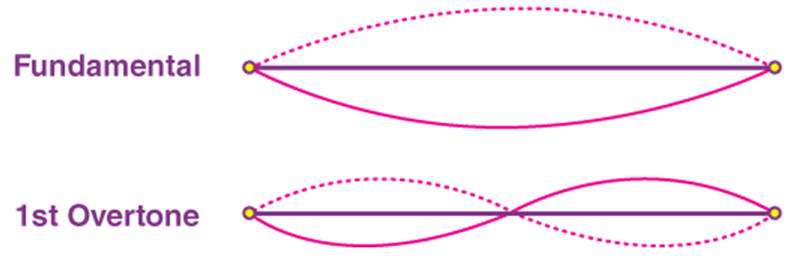
Recap for Si
Main feature at 520 cm⁻¹ is the symmetric stretching
Feature around 1000 cm⁻¹ is a two photon overtone
Features around 300 cm⁻¹ are size effects and/or disorder effects due to the crystal not being perfect

Slide 26
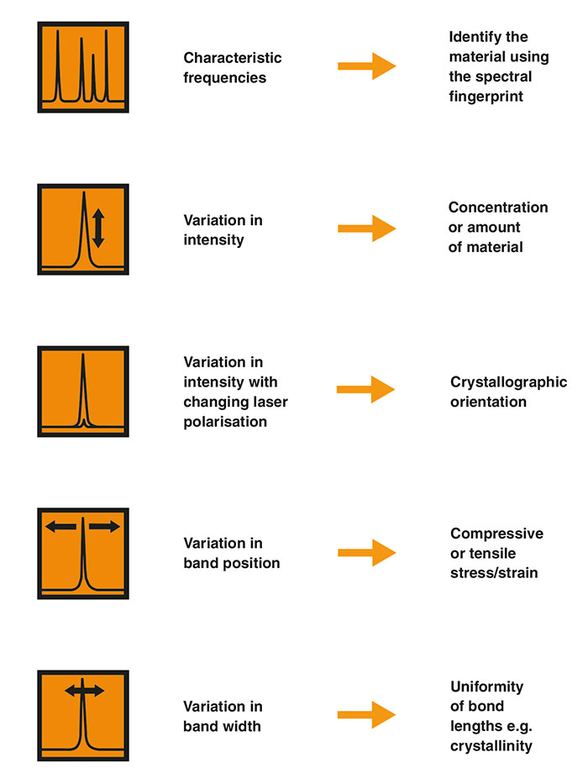
What can Raman tell you?
Raman shifts are directly linked to changes in bond length and altered atomic distances. Increased compressive stress shortens bond lengths and shifts Raman peaks to higher frequencies, while tensile stress lengthens them and causes shifts to lower frequencies.

Slide 27
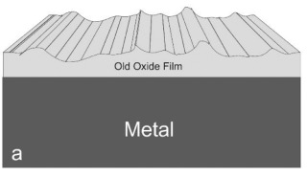
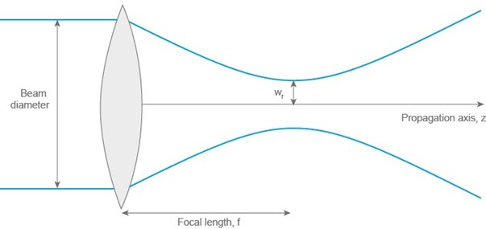
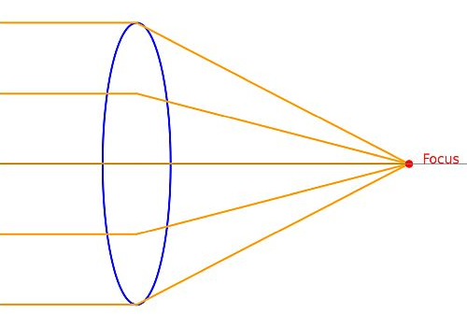
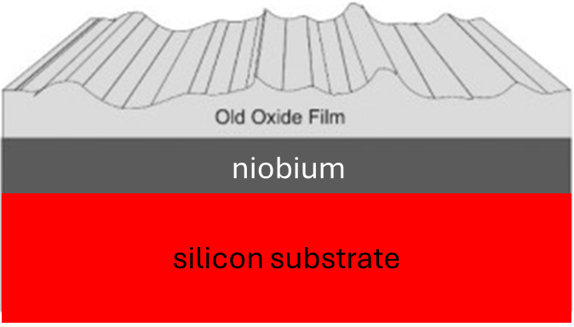
Pure Nb is not Raman active, but it’s oxides are. And that’s great because it is its oxides we want to know about.
Since signal will be dominated by Si, we really are only going to pick up the largest features from whatever oxide we have.
niobium
silicon substrate
Since the oxides are on the surface, focusing will matter.
Which do we want?
Notes:
Real beams don’t focus perfectly, but you want it to be as small as possible in the region of interest. We aren’t going to avoid some Si signal as long as we are on the sample. We are still going to have to either ignore it or subtract it out somehow.
Why Niobium is Raman-inactive
Metallic nature: Niobium (Nb) is a metal. The free electrons in metals create a screening effect that prevents light from penetrating more than a few nanometers, resulting in a very weak scattered signal. In contrast, the Raman signal in non-metals comes from light interacting with the molecular or lattice vibrations.
Cubic symmetry: Elemental niobium has a highly symmetric body-centered cubic (BCC) crystal structure. In such a simple, highly symmetric structure, the atomic vibrations (phonons) do not produce the required change in polarizability, making the first-order Raman scattering process forbidden by symmetry selection rules.
Contrast with compounds: Niobium compounds, like niobium pentoxide (Nb2O5cap N b sub 2 cap O sub 5
𝑁𝑏2𝑂5
), are Raman-active because they are not pure metals and their structures have lower symmetry. Their vibrational modes involve changing Nb-O bond distances and angles, which creates the necessary change in polarizability.

Slide 28
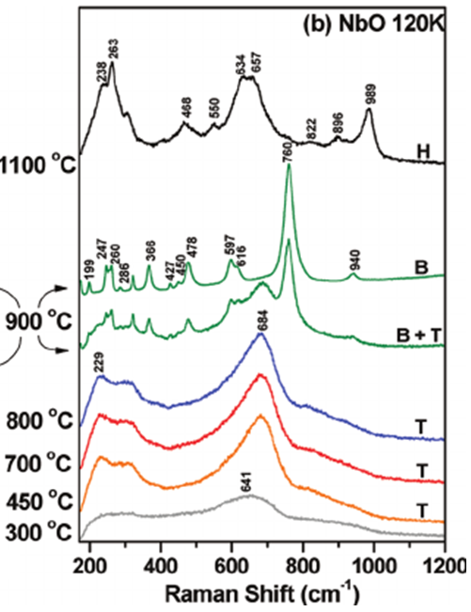
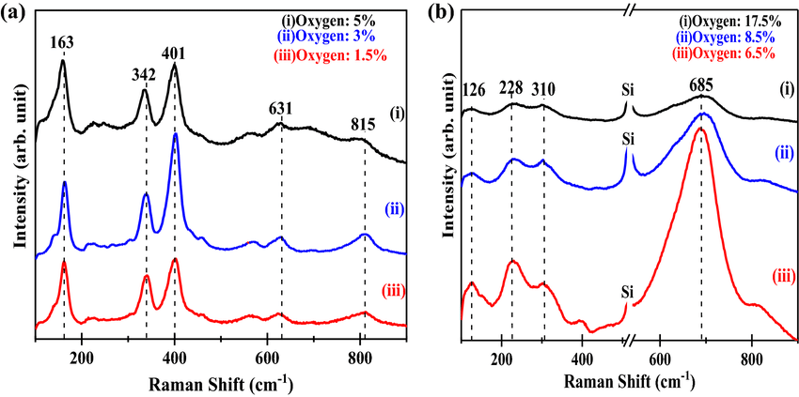
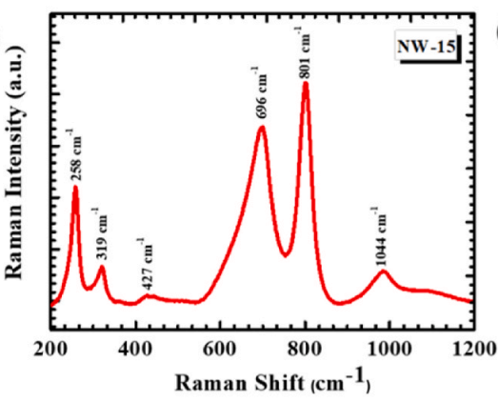
Spectra can vary a little from reference to reference. Could be differences in phase
Temp helps crystallize
dx.doi.org/10.1021/jp110672u
DOI: 10.1007/s10854-019-01319-8
Lit search | Low | Mid | High
Nb2O5 | 126, 228, 249-258 | 310-319, 426-427 | 685-697 wide, 801, 976-1044
NbO2 | 163 | 342, 401 | 631, 811-815
NbO (T) | 229, 300 |  | 641
NbO (B) | lots | lots | 760, 940
NbO (H) | 238, 263 | 468, 550 | 634-657, 822, 896, 989
Green are biggest, sym stretch
https://doi.org/10.1016/j.jpowsour.2024.234930
Notes:
A random selection of references I looked at. Probably looking at others isn’t a bad idea.

Slide 29
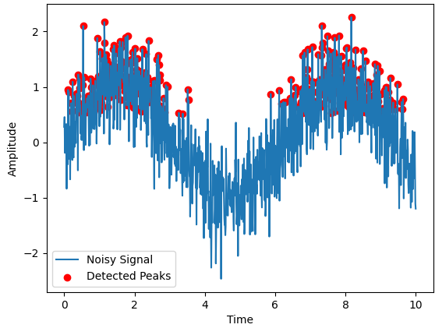
How should we decide where our peak is?
Particularly when we have less data than this, a lot of students think you should take the time with the highest intensity. What do you think?

Slide 30
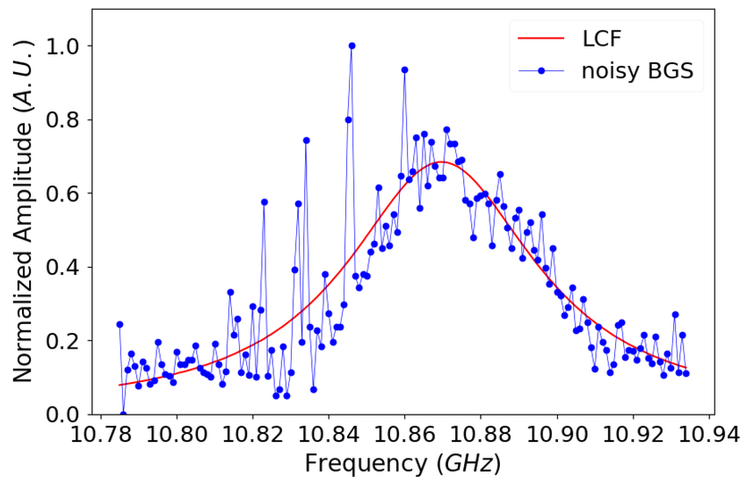
Some optics data
(Details irrelevant)
DOI: 10.3390/photonics7040079

Slide 31
If you didn’t have the time to fit this perfectly, what could you do?
Notes:
Taking a guide to the eye and estimating the middle is at least better than using the highest intensity. For this class, that is probably ok if you are low on time, but I recommend learning to fit it IF you do have time. It’ll be good practice for later things you do.

Slide 32

Fitting peaks

Slide 33
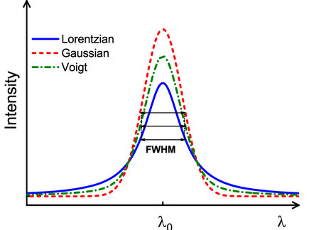
Real data had some spread to it
When we measure data, the shape of a peak can tell us something about what is causing the broadening.
If every atom or molecule is behaving the same way (called homogeneous broadening), the peak often looks like a Lorentzian, with sharper tops and longer “tails” on the sides. This can happen when the main reason for broadening is the natural lifetime of the excited state.
If different atoms or molecules are behaving a little differently (for example, because of variations in the environment or because of the instrument’s limits), the broadening is inhomogeneous. Then the peak usually looks more like a Gaussian, which has a smoother, bell-curve shape.
In practice, many real peaks are a mix of both effects, so we often use a Voigt profile, which combines Lorentzian and Gaussian shapes, to fit them best.

Slide 34
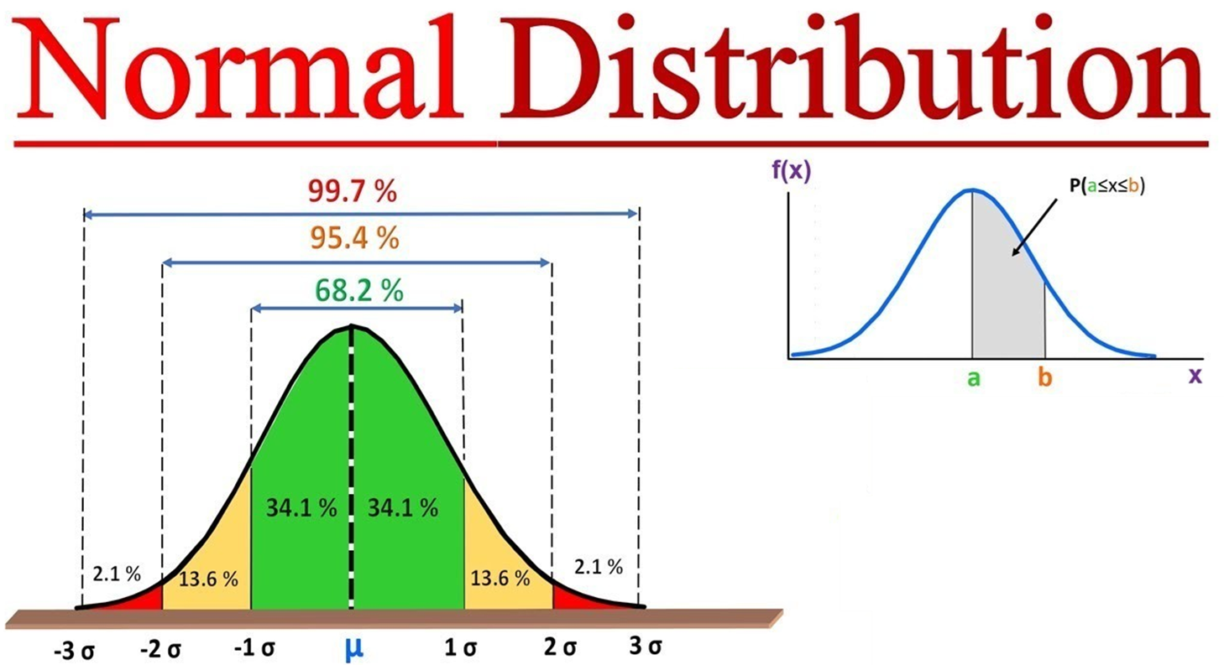
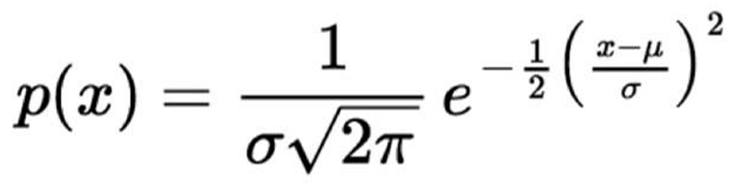
Gaussian

Slide 35
How do I know which one?
Best practices is to try all three models and compare the statistical goodness-of-fit measures (such as chi-squared) to see which model provides the best fit to your experimental data. A visual inspection of the residuals and the shape of the peaks, particularly their tails, can also provide valuable clues about the underlying distribution.
Use Fitting Software:
  Employ scientific software (e.g., Read the Docs, Desmos.com, Origin, Igor, or Wolfram Language) that supports fitting with these models.
  Perform separate fits for the Gaussian, Lorentzian, and Voigt functions.
Compare the Fit Quality 2 WAYS!:
  Statistical Metrics: After each fit, evaluate the goodness-of-fit using metrics like the reduced chi-squared statistic. The model with the lowest reduced chi-squared value and a reasonable chi-squared value is generally a better fit.
  Residuals: Inspect the residuals (the difference between your data and the fitted model). A good fit will have residuals that are randomly scattered around zero.

Slide 36
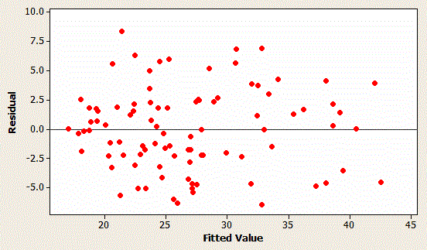
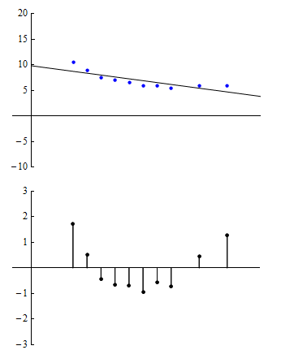
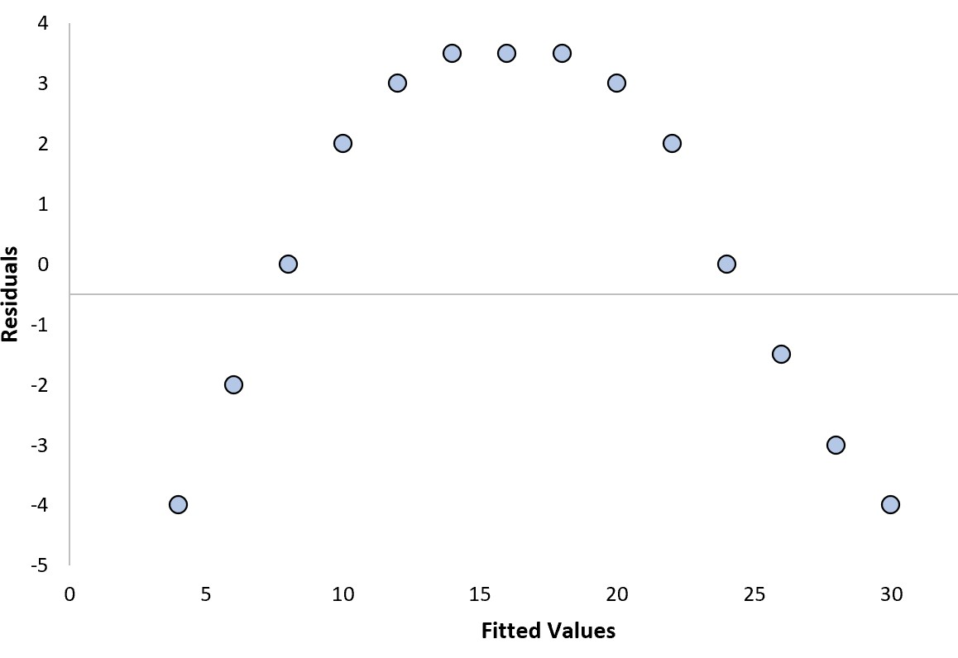
Good versus Bad residuals
Residuals are the differences in data points with respect to your fit line
Notes:
Good residuals should look random and not have a clear trend

Slide 37
Today’s topics
Intensity
Raman Shift (cm⁻¹)
Laser safety basics
Discussion of Raman spectroscopy
How to identify peak locations
Femi (fda00001@mix.wvu.edu) covered: (Feel free to email him with questions.)
Smoothing noisy data
Digitalizing reference data (don’t forget to cite it!)

Slide 38
How I’m grading the project proposal:
Are these questions sufficiently answered?
From whom will you get your sample? (probably most from Holcomb but up to you)
What material will you measure? Why did you pick this material?
What kinds of measurements are planned?
What do you think you will learn about?
Why do you think this work could be important?
If doing MOKE, do you have a particular focus from the setup that interests you?

